Slide 1

Chhattisgarh Swami Vivekanand Technical University
University Teaching Department
Department of Computer Science and Engineering
Presented By
Name: Aayushi singh Roll No.: 300012721002
Branch: CSE(AI)
Minor Project Presentation On
Automation in agriculture using Machine learning and Deep learning
Name: Ruchi shukla
Roll No.: 300012721005
Branch: CSE(AI)
Name: Shristi sahu
Roll No.: 3000127210011
Branch: CSE(AI)

Slide 2
Content
Problem Statement
Literature Survey
Research Methodology
Expected Outcome
Discussions
Scope of Project
Progress So far
References
2

Slide 3
Problem Statement
Current agricultural practices result in suboptimal crop yields.
Farming processes are inefficient due to lack of data-driven decision making.
Soil toxicity levels and health are unknown, hindering sustainability.
Variable product quality and productivity losses due to insufficient data analysis and automation capabilities.
Crop growth, pests, and diseases pose unpredictable risks to yields and revenue.
2

Slide 4
Literature Survey
AUTH0R | TITLE | PURPOSE | ALGORITHM | ACCURA CY
P. S. Vijayabaskar, Sreemathi R., Keertanaa E.2017 | "Crop Prediction Using Predictive Analytics" | To help farmers analyze soil fertility, suggest suitable crops, recommend fertilizers, and provide regional crop information using predictive analytics. | Predictive modeling using sensors, focusing on soil parameters and environmental factors. | 89℅
George F. Luger, 2018 | Artificial Intelligence: Structures and Strategies for Complex Problem Solving | To provide a comprehensive introduction to artificial intelligence, focusing on problem-solving strategies, the theory behind AI, and various algorithms used in the field. | The book covers a wide range of algorithms, including Bayesian networks, genetic algorithms, neural networks, and state space search algorithms. | 90%
Susmita Ray, 2019 | A Quick Review of Machine Learning Algorithms | The paper reviews popular machine learning algorithms, their merits, demerits, and applications. The aim is to help in informed decision-making when selecting an algorithm for specific use cases. | Gradient DescentLogistic RegressionSupport Vector Machines (SVM)K-Nearest Neighbor (KNN)Artificial Neural Networks (ANN)Decision TreesBayesian LearningNaïve BayesK- Means ClusteringBackpropagation Algorithm | 93.3%
M. Kalimuthu, P. Vaishnavi, M. Kishore, 2020 03-10-2024 | Crop Prediction using Machine Learning" | To assist farmers, especially beginners, in predicting the most suitable crops for their land using machine learning techniques, specifically the Naive Bayes classifier, based on parameters like temperature, humidity, and soil moisture. | Naive Bayes (Gaussian Naive Bayes Classifier) 4 | 97%,

Slide 5
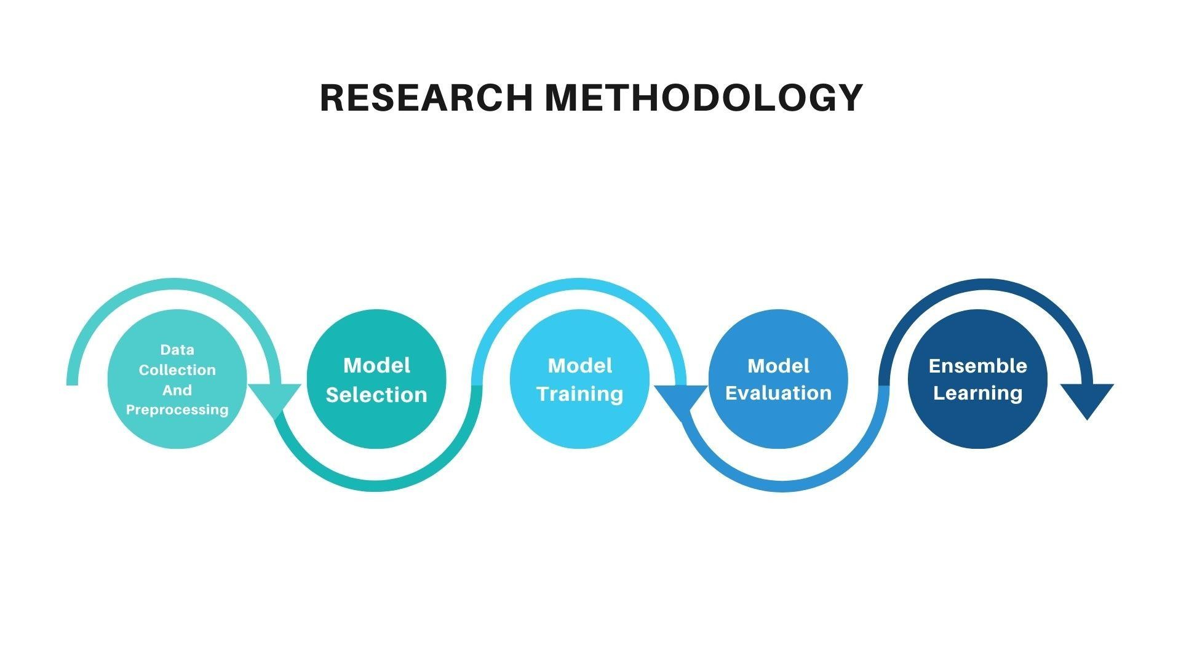

Slide 6
Expected Outcome
Increased crop yields: through precision agriculture driven by AI and data analysis, leading to optimized resource use.
Enhanced efficiency in farming processes :due to automated decision-making
and task execution, resulting in reduced labor and resource wastage.
Improved soil health management: with real-time monitoring and predictive insights helping maintain soil fertility and reducing toxicity.
Consistent product quality : and minimized productivity losses, driven by data
analysis and AI, which allow for timely interventions.
Reduced risks from crop growth issues, pests, and diseases: thanks to predictive analytics that provide early warnings and proactive solutions, ultimately stabilizing yields and revenue.

Slide 7
Discussions
Project Overview: In this project we have used machine learning and data analytics to assist farmers in making informed decisions on crop selection, fertilizer usage, and disease detection, improving productivity and reducing risks.
Problem Addressed: Climate change and unpredictable weather patterns disrupt traditional farming. This project helps predict suitable crops based on soil conditions, temperature, and rainfall, addressing uncertainties faced by farmers.
Key Features: The project focuses on crop analysis, fertilizer recommendation, and disease detection, using various machine learning algorithms like Random Forest and XGBoost for accurate predictions.
Impact: The project empowers farmers by providing data-driven insights, enhancing crop yield and sustainability, while reducing the reliance on traditional methods vulnerable to weather changes.

Slide 8
Scope of Project
Address food security challenges with AI and Machine Learning-
Recommend sowing dates and cropping patterns to boost yields- Forecast seed production needs using historic data and weather forecasts-
Identify soil defects and nutrient deficiencies with ML and Deep Learning-
Detect plant diseases and pests using computer vision technology-
Enhance farmer productivity and minimize losses with data-driven insights.

Slide 9
Progress So far
We have made significant progress in our project so far. The key accomplishments include:-
Literature Research: We have thoroughly reviewed 4 research papers to gain
insights and understanding of the domain.-
Model Development: We have initiated the development of three critical models:
Crop Recommendation System
Fertilizer Suggestions System
Disease Detection System

Slide 10
References
M. Kalimuthu, P. Vaishnavi and M. Kishore, "Crop Prediction using Machine Learning," 2020 Third International Conference on Smart
Systems and Inventive Technology (ICSSIT), 2020, pp. 926-932, doi: 10.1109/ICSSIT48917.2020.9214190.
P. S. Vijayabaskar, R. Sreemathi and E. Keertanaa, "Crop prediction using predictive analytics," 2017 International Conference on
Computation of Power, Energy Information and Commuincation (ICCPEIC), 2017, pp. 370-373, doi: 10.1109/ICCPEIC.2017.8290395.
M. Keerthana, K. J. M. Meghana, S. Pravallika and M. Kavitha, "An Ensemble Algorithm for Crop Yield Prediction," 2021 Third
International Conference on Intelligent Communication Technologies and Virtual Mobile Networks (ICICV), 2021, pp. 963-970, doi: 10.1109/ICICV50876.2021.9388479.
Stuart J. Russell and Peter Norvig, "Artificial Intelligence A Modern Approach ―Second Edition" Pearson Education.
SarojKaushik ―Artificial Intelligence‖ , Cengage Learning.
George F Luger ―Artificial Intelligence‖ Low Price Edition , Pearson Education., Fourth edition.
P. Louridas and C. Ebert, "Machine Learning," in IEEE Software, vol. 33, no. 5, pp. 110-115, Sept.-Oct. 2016, doi: 10.1109/MS.2016.114.
S. Ray, "A Quick Review of Machine Learning Algorithms," 2019 International Conference on Machine Learning, Big Data, Cloud and
Parallel Computing (COMITCon), 2019, pp. 35-39, doi: 10.1109/COMITCon.2019.8862451.
Tom M.Mitchell ―Machine Learning‖ McGraw Hill

Slide 11

Thank you
10/3/2024
11

